Slide 1
Neutral Atom Qubits
Jeremy Chen

Slide 2
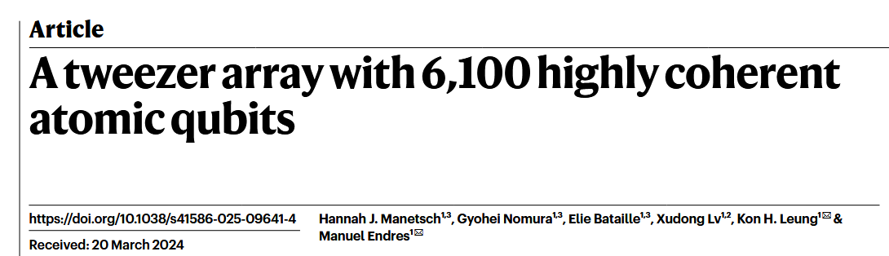
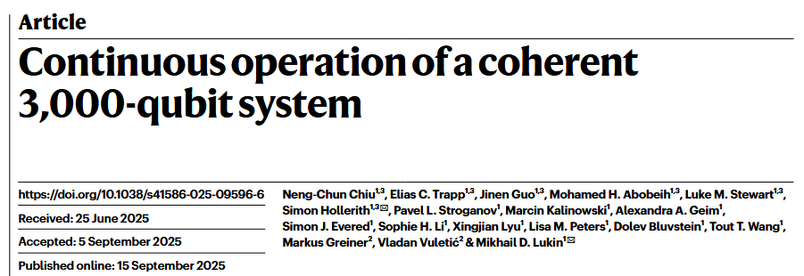
A Quick Introduction
Neutral atom computing came about due to innovations in optical tweezer technology
Much of the appeal of neutral atoms is from “laser-cooled” atoms, which allow singular atoms to be precisely manipulated en-masse
The atoms used are called “Rydberg atoms”, which are atoms with high quantum number electrons
The distance of the electrons from the nucleus gives it more “sensitivity” to electromagnetic fields

Slide 3
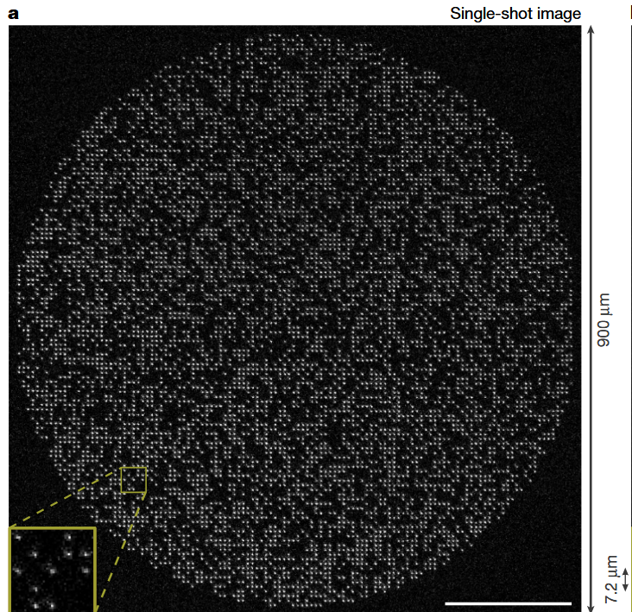
The Physical Model
The physical model of the neutral atom computer is given by the Rydberg formula, which describes Rydberg atoms
Rydberg atoms have high n quantum numbers in their electrons
The high sensitivity to electric fields makes Rydberg atoms significantly easier to manipulate with atomic tweezers
The specific way in which the electric field is applied to a Rydberg atom is what gives the unique qubit interactions

Slide 4
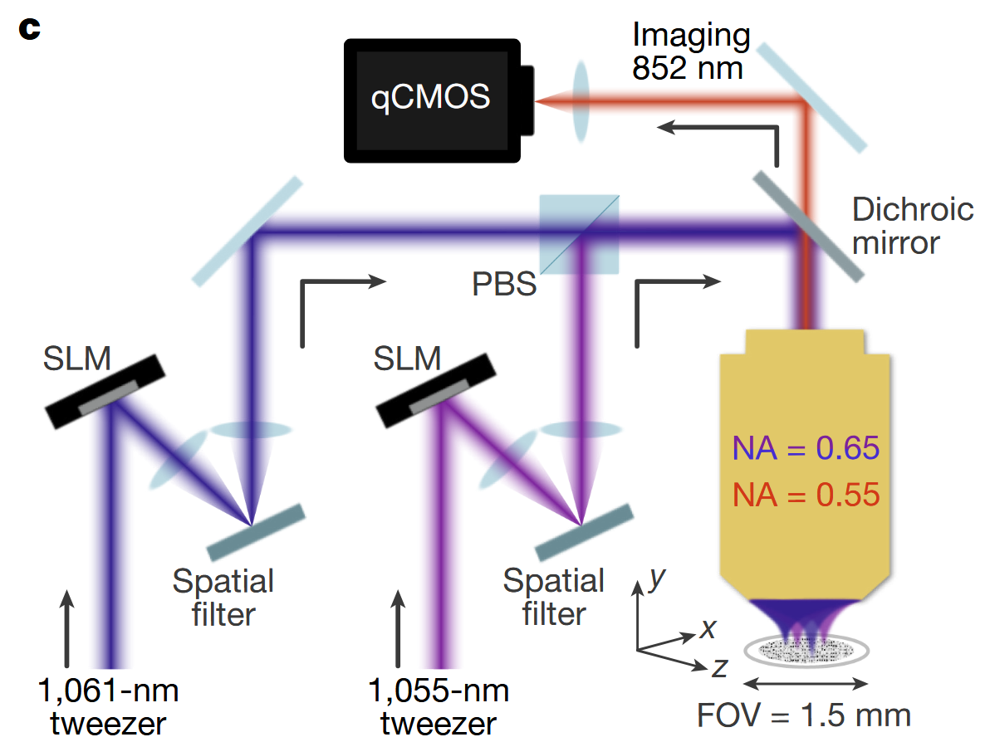
Physical Implementation
Neutral atom qubits are implemented using “atomic tweezers”
All 5 DiVincenzo criteria could be fulfilled with neutral atom qubits
The ground state and excited states are clearly demarcated with the Rydberg states
The initialization with lasers sets everything in the ground state without excitation
Coherence times are long, over 20 minutes for the state of the art
Qubit gates are complete with Clifford and phase shift gates
The readout is accurate and happen en-masse

Slide 5
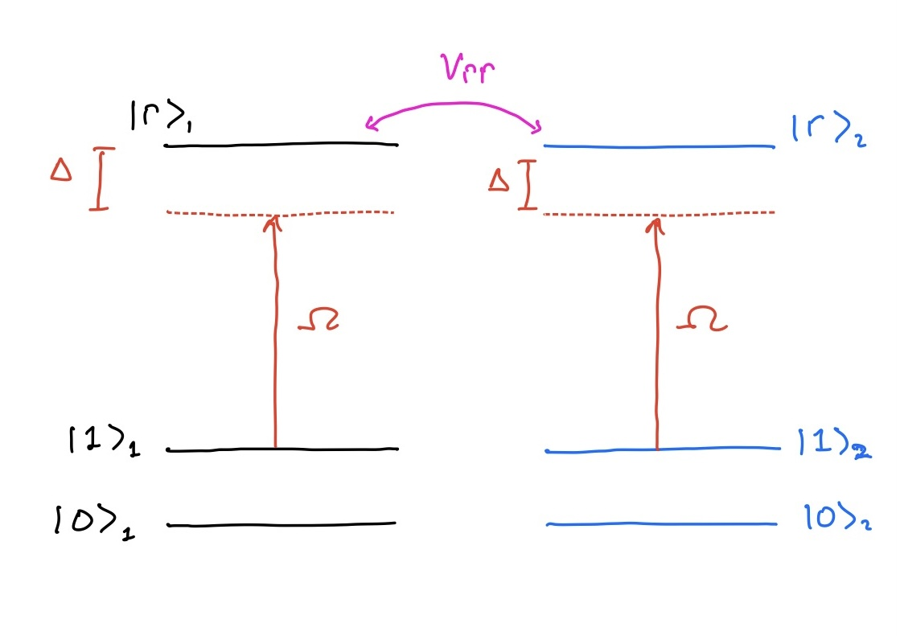
Qubit Operation
The fundamental principle that qubit operations are done is the Rydberg blockade
This increases qubit connectively whilst simultaneously reducing neighboring qubit interactions
Let’s look at a basic 2 qubit entanglement
For two qubits to interact, they both need to be excited beyond the |1> state to |r>
The Rydberg blockade makes the system “detuned” from the rest of the qubits

Slide 6
Future
The future of neutral atom quantum computing is very promising, given its current track record against other modalities
It has achieved higher qubit count, doesn’t require cooling, has long coherence times, and is highly scalable
That being said, much of its technology is highly experimental and expensive, not to mention, as of now, incompatible with the semiconductor industry

